Slide 1
Digital Trade
Data Flows and Data Localization

Slide 2
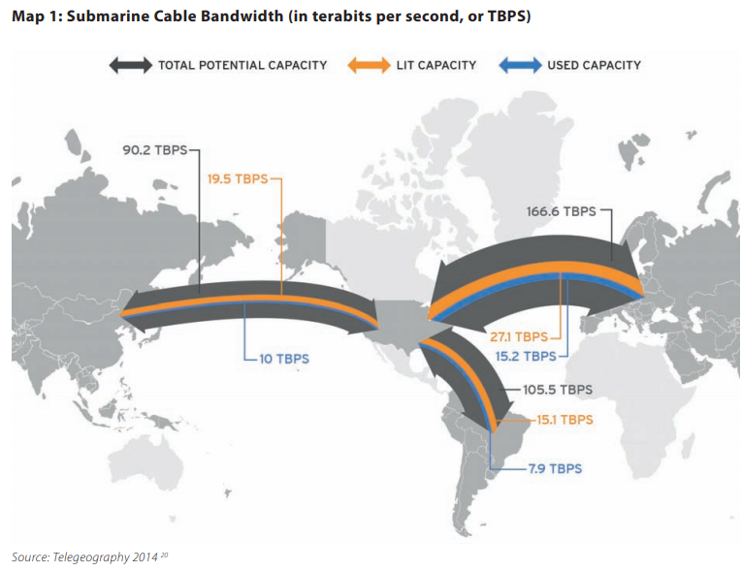

Slide 3
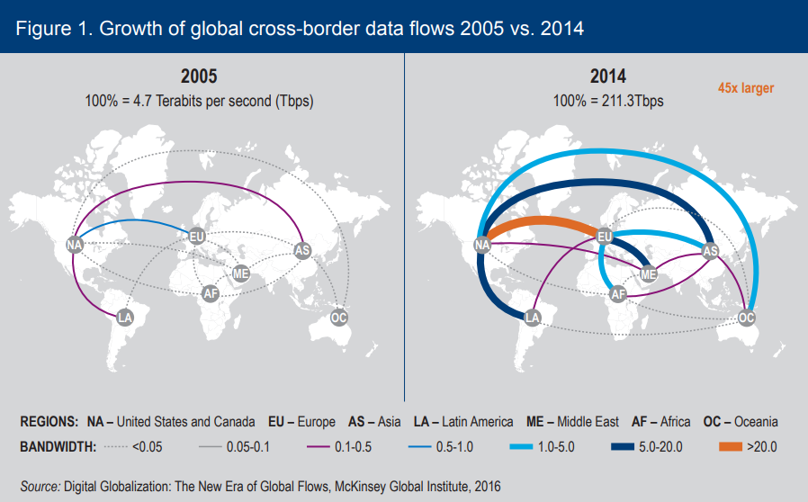

Slide 4
Global Digital Trends
3.7 billion people have access to the internet – but over 50% of the world does not have internet access
Internet access is mobile
  75% mobile access in Indonesia
Entire economies are becoming digital
Transformation in international trade

Slide 5
Digital Economy and Trade Opportunities
Global data flows raised GDP by 3.5%, or ~$2.8 trillion in 2014 and up to $11 trillion by 2025 (McKinsey 2016)
A 10 percent increase in internet penetration in the exporting country leads to a 1.9% increase in export (World Bank)
Ecommerce sales was over $25 trillion in 2015 (UNCTAD 2017)
  90% B2B, 10% B2C
  Cross-border B2C was $189bn in 2015

Slide 6
Data Flows as Key to Digital Trade
Cross border data flows that are required for international trade
  Goods and services purchased online but delivered offline e.g. ecommerce
  Services purchased and delivered online e.g. professional, education, cloud computing, IoT
  Content delivery e.g. movies, books, social networks
2. Cross border data flows that enable international trade
  Internal company data flows e.g. HR, communication, data sharing and analysis, managing GVC
  Innovation, R&D, Big data, AI development

Slide 7
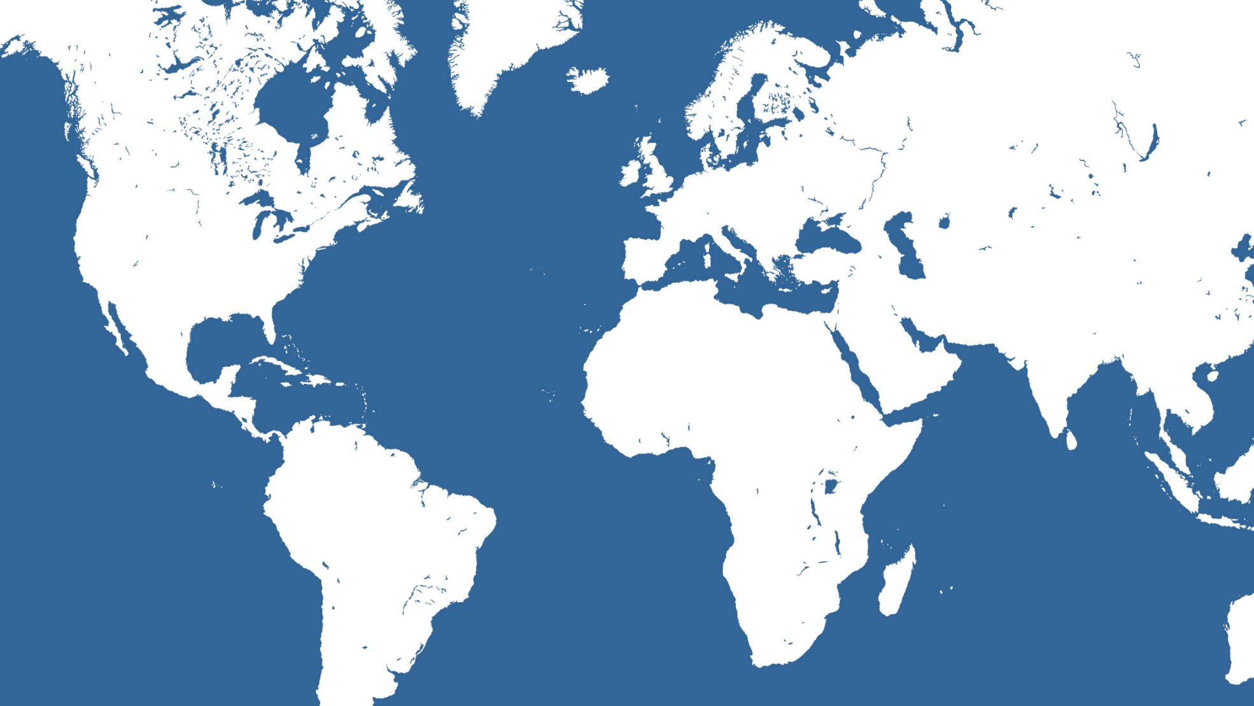



Cloud Computing

Slide 8






Big Data Opportunities

Slide 9







Internet of Things

Slide 10









Ways IoT Devices Connect to the Internet
Bluetooth
Device-to-device
architecture
Smartphone application
Smart lightbulb
Cellular connection
Device-to-cloud architecture
Cloud
Vehicle with monitoring device
Bluetooth
Wi-Fi, Cellular connection
Cloud
Device-to-gateway architecture
Fitness tracker
Gateway (smartphone)
Wi-Fi
Device-to-cloud architecture
Cloud 1
Wi-Fi
Cloud 2
Wi-Fi
Thermostat
Smart lightbulb

Slide 11
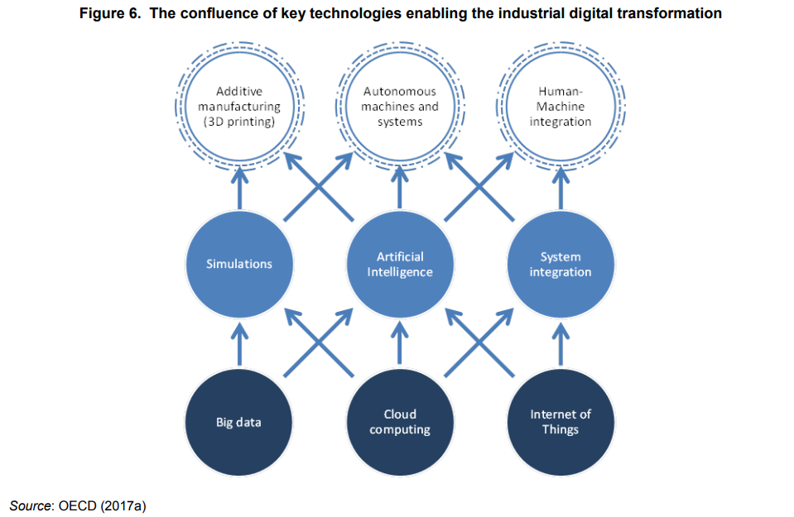

Slide 12
Digital Transformation of Trade
Platforms
Digital Services
Increased services value-add in manufacturing
Global Value Chains

Slide 13


Digital Platforms

Slide 14
Trade over Digital Platforms

Slide 15





Trade in Services

Slide 16
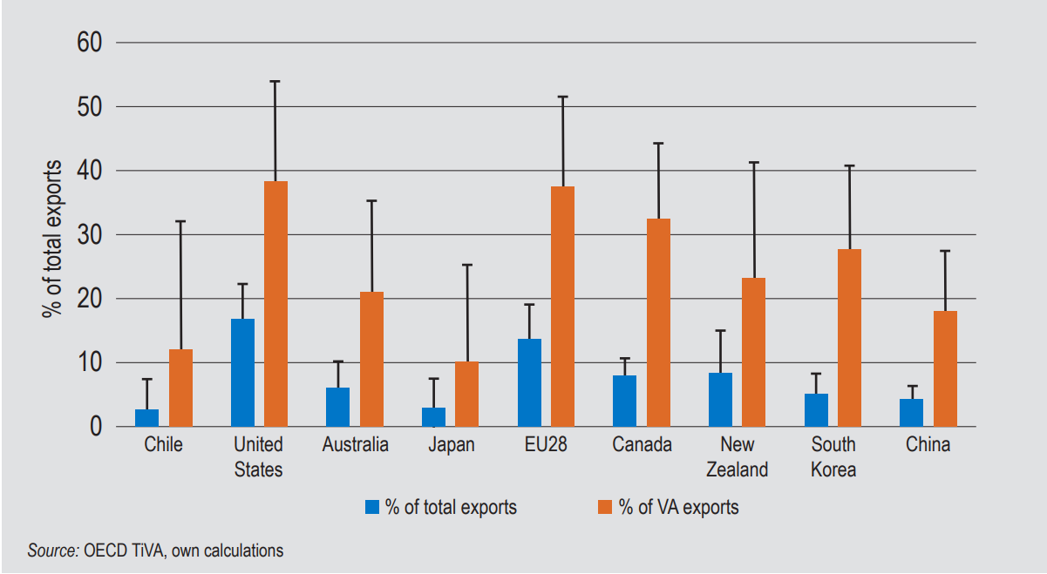
Digitally-deliverable services

Slide 17



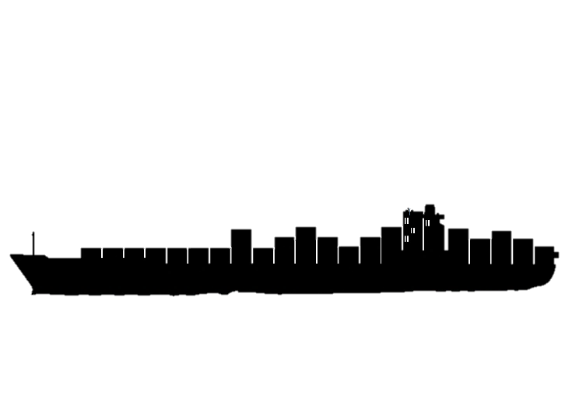
Digitization of Goods
Digital services
Goods

Slide 18





Global Value Chains

Slide 19
Evolution and nature of data transfer restrictions
Growing in number and in complexity…
Mainly horizontal and involving personal data, but also health, financial, public and telecom data

Slide 20
Reasons for data localization
Privacy
Law Enforcement
Cybersecurity
Censorship
Protectionism

Slide 21
Costs of Data Restrictions
Limits access to digital commerce networks and online resources
Limits the ability of businesses to synthesize large data sets
  Applies to data processing and internet services, and businesses that depend on data for delivery
Affects business models, reduces productivity, innovation, and business competitiveness
Forces businesses to invest in what are frequently lower quality data facilities

Slide 22
Impact of proposed data localization
Country | Less economic growth | Less investment
China | 1.1 | 1.8
EU 28 | 0.4 | 3.9
India | 0.1 | 1.4
Indonesia | 0.5 | 2.3
South Korea | 0.4 | 0.5

Slide 23
Digital Trade Commitments in the WTO
WTO GATS
WTO Understanding on Commitments in Financial Services
WTO GATT
WTO Information Technology Agreement
WTO Telecommunications Annex
WTO Trade Facilitation Agreement
WTO TRIPS Agreement
WTO TBT Agreement

Slide 24
11th Wto ministerial, Buenos Aires 2018
Work Programme on Electronic Commerce
  Continue work based on existing mandate
  Agree to maintain current practice of not imposing customs duties on electronic transmission
Joint Ministerial Statement on Electronic Commerce
  U.S. Australia, Canada, Chile, Colombia, EU, China, Japan, Korea, Malaysia, Mexico, New Zealand, Russia, Singapore, Switzerland, Turkey and others
  We, as a group, will initiate exploratory work together toward future WTO negotiations on trade related aspects of electronic commerce. Participation will be open to all WTO Members and will be without prejudice to participants' positions on future negotiations.

Slide 25
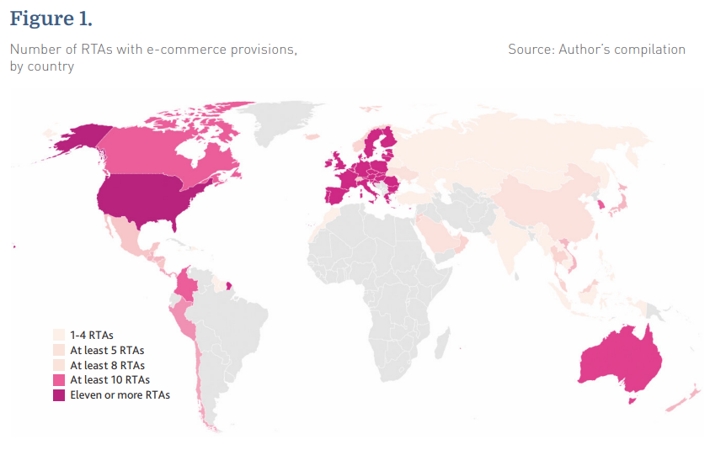
Digital trade in free trade agreements

Slide 26
Comprehensive and progressive Agreement for
Trans-Pacific Partnership
Free flow of information subject to exceptions
No data localization
No source code disclosure
Access to internet and use of applications
Importance of interoperability amongst privacy regimes
Intellectual Property – third party intermediary liability and balanced copyright law

Slide 27
USMC Trade AgreEment (NAFTA 2.0)
Prohibit customs duties and other discriminatory measures from being applied to digital products distributed electronically (e-books, videos, music, software, games, etc.).
Commitments to free flow of data and no data localization (including for financial data)
No source code disclosure
Collaboration with industry in tackling cybersecurity challenges
Promote open access to government-generated public data
Limit third party intermediary liability
Canada to raise De Minimus to C$150

Slide 28
New Digital Trade Commitments?
US-Japan FTA
US-EU FTA
US-UK FTA

Slide 29
Digital economy and trade project
www.brookings.edu/digital-economy-and-trade-project/

